Slide 1
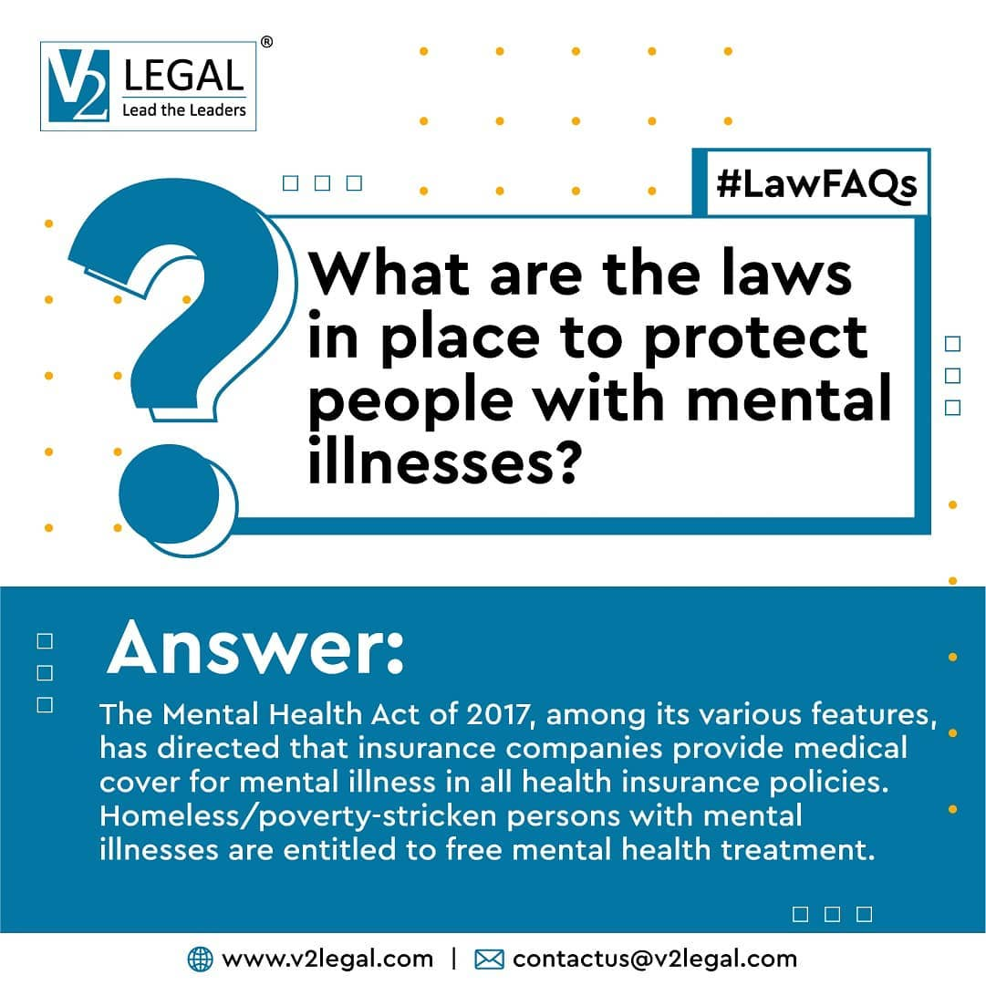
Only recently have authorities like the IRDAI recognized the need for mental illnesses to be covered by insurance providers. As the pandemic has grown, so had the need for opening new avenues for well-being in the nation. What do you think of India's laws on mental illnesses? Let us know in the comments! Follow us to keep yourself updated with all things law. Website: www.v2legal.com Facebook: https://www.facebook.com/v2legalfirm Instagram: https://www.instagram.com/v2legal/ LinkedIn: https://www.linkedin.com/company/71667874/ Twitter: https://twitter.com/V2Legal Contact us: +91 63748 45310 . . . . . #LegalIndian #TreasureTroveAct #Litigation #SupremeCourt #FollowForLawUpdates #llb #law #indianlaw #lawyersofinstagram #quotable #quotesonlaw #LawEnforcement #LikeForLikes #lawsuits #lawfacts #chennailawyer #instalawyers #lawschool #instagood #mentalhealth #mentalwellbeing #LegalJargon #LawFAQs # #mentalhealthsupport #MentalIllness #wordsporn #lawyerlife #Judiciary #mentalhealthawareness

Slide 2

The remark was delivered by the Supreme Court during a landmark judgement in a petition filed by the Election Commission seeking to restrain the media from reporting oral remarks made by judges after the Madras High Court said that the ECI "should probably be booked for murder" by allowing election rallies. Follow us to keep yourself updated with all things law. Website: www.v2legal.com Facebook: https://www.facebook.com/v2legalfirm Instagram: https://www.instagram.com/v2legal/ LinkedIn: https://www.linkedin.com/company/71667874/ Twitter: https://twitter.com/V2Legal Contact us: +91 63748 45310 . . . . . #LegalIndian #mediacoverage #Litigation #SupremeCourt #FollowForLawUpdates #llb #law #indianlaw #lawyersofinstagram #LawEnforcement #LikeForLikes #lawsuits #lawfacts #chennailawyer #instalawyers #lawschool #instagood #LegalJargon #LawFAQs #wordsporn #lawyerlife #Judiciary #IndianConstitution #FreedomofPress #PressCoverage #SocialMedia #NewsCorrespondent #NewsUpdates #LawUpdatesIndia #ElectionCommission

Slide 3
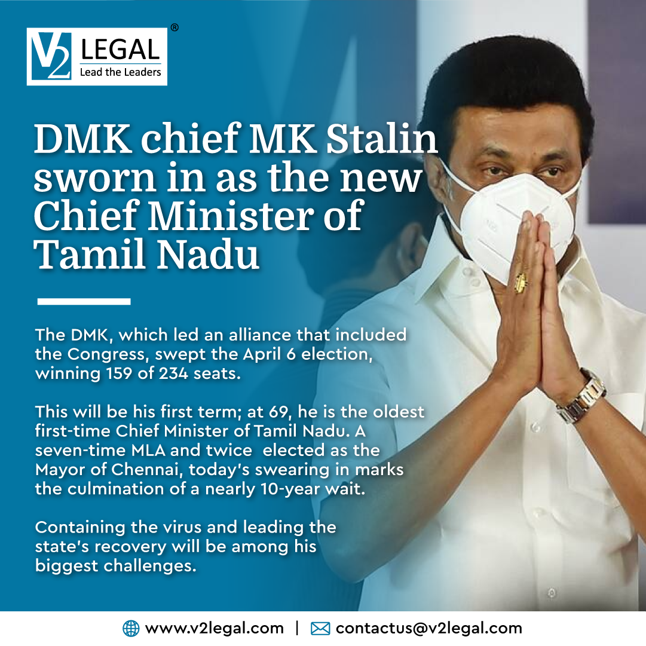
Shri MK Stalin is sworn in as the 13th Chief Minister of Tamil Nadu. S Regupathy has been given the Law Ministry. Appointment of Advocate General, Additional Advocate Generals, Govt. Pleader and Public prosecutor for the state are to be appointed soon. Follow us to keep yourself updated with all things law. Website: www.v2legal.com Facebook: https://www.facebook.com/v2legalfirm Instagram: https://www.instagram.com/v2legal/ LinkedIn: https://www.linkedin.com/company/71667874/ Twitter: https://twitter.com/V2Legal Contact us: +91 63748 45310 . . . . #TNElections #LawUpdates #SouthIndia #IndianPolitics #DMK #MKStalin #TN #ChiefMinister #TamilNadu #Elections2021 #SupremeCourt #tnelectionmanifesto #V2Legal #LegalUpdates #LegalKnowledge #LifeOfaLawyer #LawyerLife #LawyersOfInstagram #LawFirm #LawSchool #LawStudent #LawAgency #Lawyer #LawUpdatesIndia #InstaLawyers #FollowForLawUpdates #LawUpdatesIndia #HighCourt #SupremeCourt #IndianGovernment

Slide 4

One of the foundations of laws is to also be sensible and share in common sense. Do you agree? Let us know in the comments! Follow us to keep yourself updated with all things law. Website: www.v2legal.com Facebook: https://www.facebook.com/v2legalfirm Instagram: https://www.instagram.com/v2legal/ LinkedIn: https://www.linkedin.com/company/71667874/ Twitter: https://twitter.com/V2Legal Contact us: +91 63748 45310 . . . . . #LegalIndian #LegalQuotes #QOTD #quotesaboutlife #lawquotes #RulesofLaw #law #indianlaw #lawyersofinstagram #quotable #quotesonlaw #TheGoodWord #quotestoliveby #advocatesofinstagram #chennailawyer #IndianLawNews #IndianLawyersClub #lawschool #Kanoon #quotesoftheday #quotesandsayings #HowToBeaLawyer #Lawyer101 #IPC #quoteoftheday #PotterStewart #QuoteGram #quotestagram #CommonSense #SupremeCourt

